Slide 1
TSMC Smart Parking Lot Inventory Management System
[B5] ADSL X MLAD 張敬 林正明 張嫈嫈

Slide 2
Introduction

Slide 3
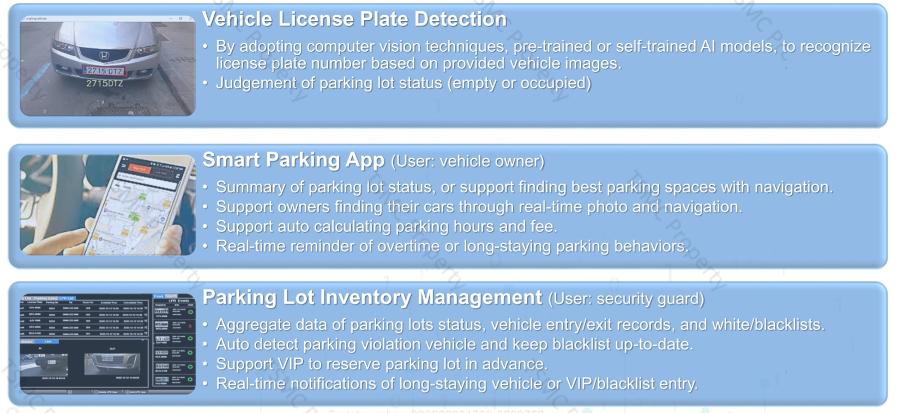
Expected System Functionalities

Slide 4
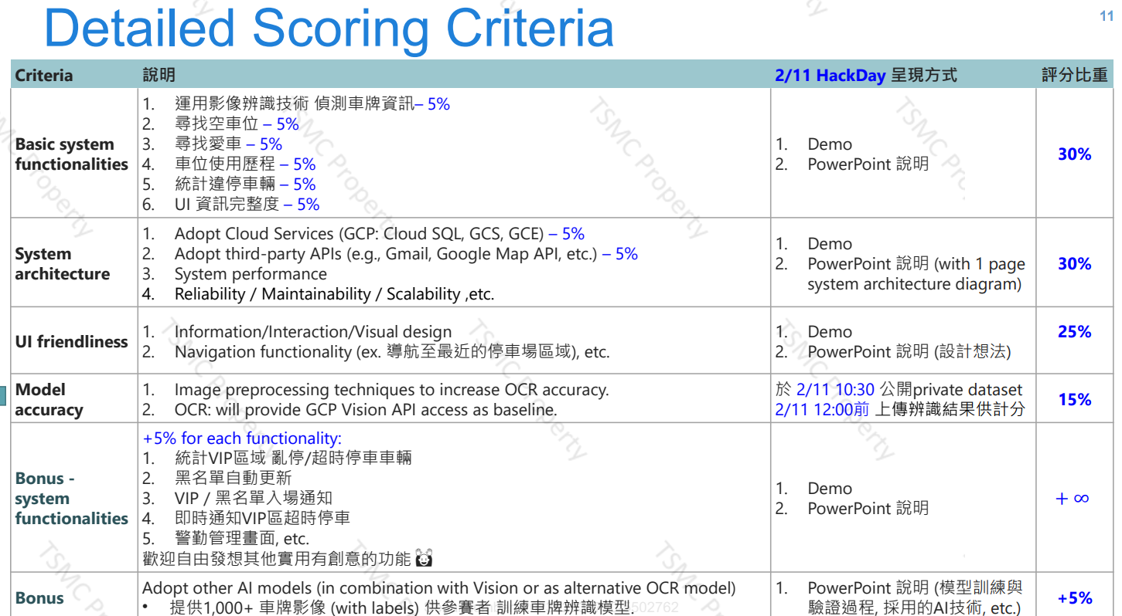
Scoring Criteria
✅
✅
✅
✅
✅
✅
✅
✅
✅
✅
✅
✅
✅
✅
✅

Slide 5
System Architecture

Slide 6









System Architecture
Data
Image
CSV
Bucket
Server
5 Table
Entry record
Reservation
Blacklist
User
WebUI
Find parking space
Cloud SQL
Find my car
Nginx
Fast API
Image OCR
Parking history
GCV
Send notification
GCE
Pushover

Slide 7
User Scenarios

Slide 8

User Scenarios (Customer)
一個風和日麗的星期六下午 4:00，
小明開著他的法拉利進入了 ADSL 停車場
那麼首先，他想找一個空車位...

Slide 9
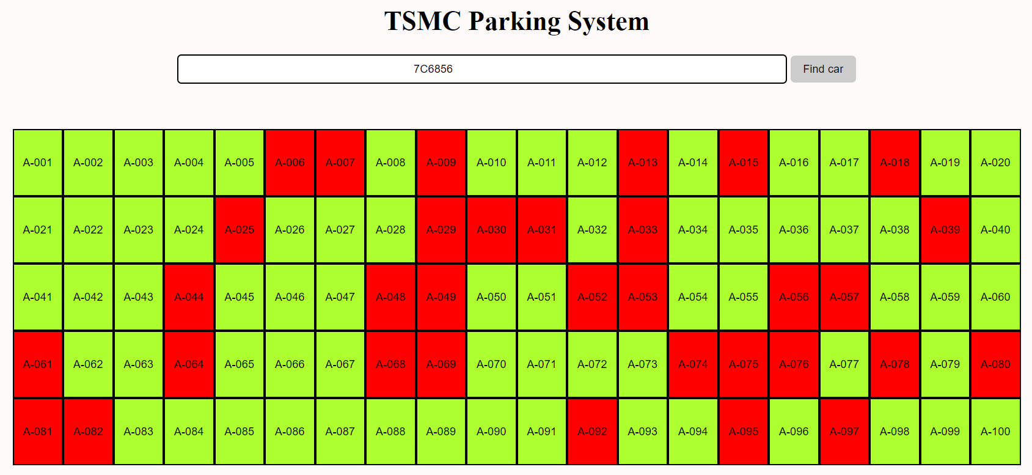
Functionalities - Find Parking Space

Slide 10

User Scenarios (Customer)
小明到附近逛逛後，準備回家！
但是...他想不起來他的愛車停在哪？

Slide 11
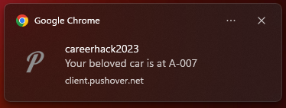
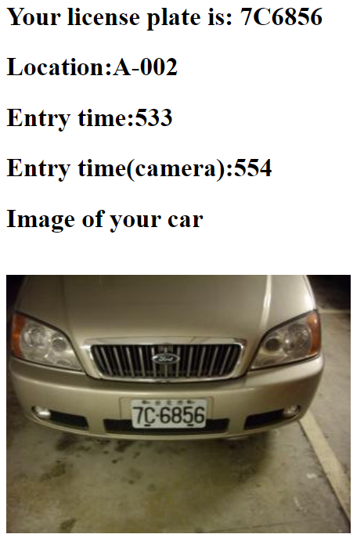
Functionalities - Find My Car

Slide 12

User Scenarios (Manager)
小美身為 ADSL 停車場的管理員，希望可以節省人力，
因此她需要能夠快速獲得入場車輛的車牌號...

Slide 13
Postprocessing with OCR
Regular Expression with Python
r"[A-Z0-9]{2}[-\s]*[A-Z0-9]{2}[-\s]*[A-Z0-9]{2}"
value = "B4-9677\n*74"
value = "B49677\n*74"
value = "B496 77\n*74"
value = "B496-77\n*74"
B49677

Slide 14
User Scenarios (Manager)
小美希望可以給顧客良好的停車環境
那麼首先，她需要能夠快速取得黑名單列表...

Slide 15
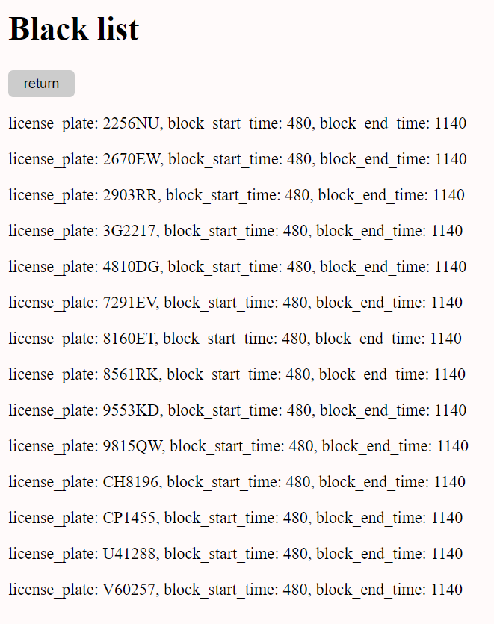

Functionalities - Black List

Slide 16
User Scenarios (Manager)
小美希望可以了解顧客偏好的停車時間、位置
因此她需要快速取得每個車位的歷史停車紀錄...

Slide 17
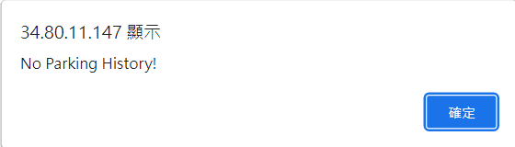
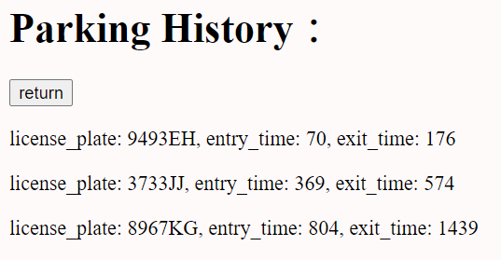
Functionalities - Parking History
Without history
Alert message
With history

Slide 18
Problem with Data

Slide 19
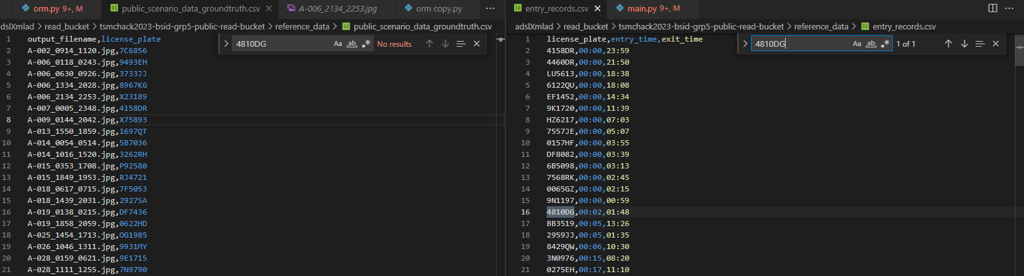
Problem with data (1/2) - entry_records without image’s file name
Ex: 4810DG (Spinning around in the parking lot for 1 hour and 46 minutes)
No result in image name list
4810DG,00:02,01:48

Slide 20
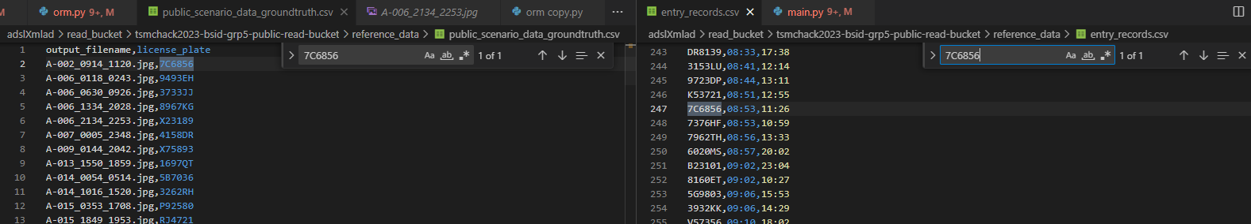
Problem with data (2/2) - Mismatched time between entry_records and image’s file name
Ex: 7C6856 (Spinning around in the parking lot for 1 hour and 46 minutes)
A-002_0914_1120.jpg,7C6856
7C6856,08:53,11:26

Slide 21
Demo

Slide 22
Thanks!

